Slide 1




ctDNA + CTC:
Accelerating Clinical
Drug Development
ISLB Annual Congress 2020
30 October 2020
Notes:
Welcome to the Predicine Liquid Biopsy Symposium.

Slide 2

Speakers
Shidong Jia, MD, PhD
Founder & CEO
Predicine
Richard Wenstrup, MD
Chief Medical Officer
Epic Sciences
Notes:
My name is Shidong Jia, Founder & CEO at Predicine.
Joining me today is Dr. Richard J. Wenstrup, Chief Medical Officer at Epic Sciences.

Slide 3
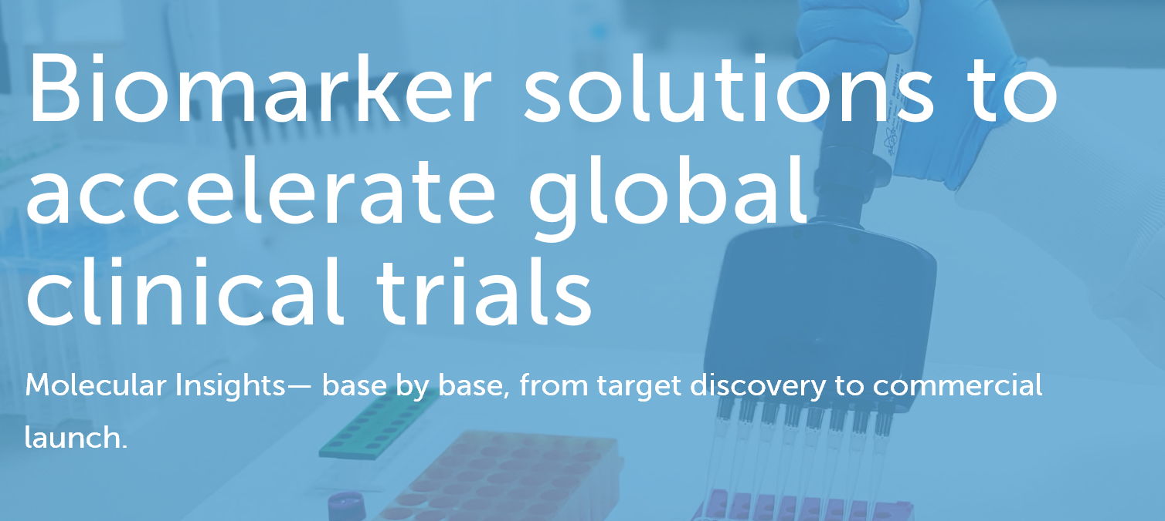
Predicine & Epic Sciences – Global Strategic Partnership
We are applying our expertise in genomic profiling to identify elusive cancer-related genetic changes and new biomarker targets across many cancer types. Our advanced cancer genome analysis helps researchers and biopharmaceutical partners accelerate new precision medicine development
Notes:
I would like to start this talk with an exciting announcement - Predicine and Epic Sciences has entered into a global strategic partnership, to offer biopharmaceutical companies access to Predicine’s ctDNA-based testing and Epic’s CTC-based testing.
Through this partnership, together, we provide a first- and best-in-class, a most comprehensive liquid biopsy biomarker solution, to biopharma partners.

Slide 4
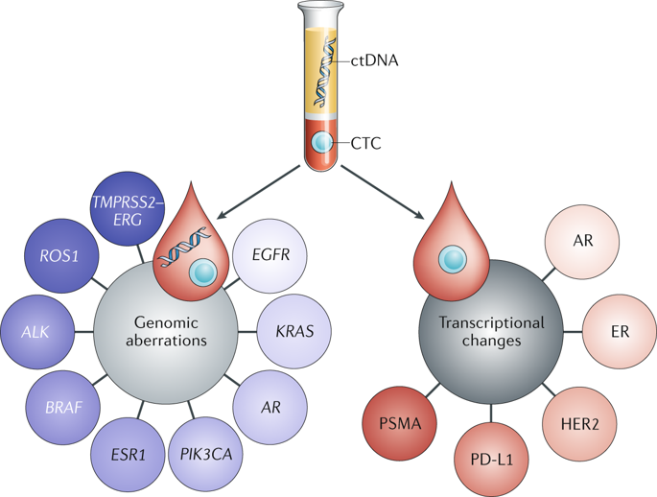


Peripheral Blood: Multiple Tools For Drug Development
Liquid Biopsy: ctDNA and CTC analysis answer different questions and are complementary
Genotypic insights
Phenotypic insights
cfDNA
CTCs
clone A
WBCs
ctDNA
CTCs clone B
ctcDNA
Tissue Biopsy
Invasive
Access challenges
Expensive
Longitudinal studies hard
Liquid Biopsy
Non-invasive
Accessible
Affordable
Longitudinal studies easier
ctDNA
A fraction of cfDNA
Aggregate population
Genomic
ctc-DNA
Cell by cell
Clonal
Genomic
CTCs
Proteomic & genomic
Protein location
Protein quantity
Cell shape changes
Pantel & Alix-Panabieres Nature Reviews 2019
Notes:
Speaking about biomarker, tissue is the gold standard in clinical practice. However, tissue is often the issue. Tissue biopsy is invasive, hard to access, expensive, and not feasible for longitudinal studies.
Recent advance in science and technology has made blood as the ideal source for biomarker profiling. Peripheral blood is rich in biomaterials, for instance, CTC and circulating DNA shedding from tumor tissue, CTC, and normal cells. Blood liquid biopsy is non-invasive, easy to access, affordable, and suitable for longitudinal studies.
On the right side, blood provide a valuable source for DNA-based genotypic insights and CTC-based phenotypic insights. For instance, ctDNA-based molecular profiling of EGFR, HER2, PIK3CA, and CTC-based immunostaining for PDL1, HER2, and Androgen Receptor protein expression.
Through this multi-technology approach, ctDNA and CTC analysis answer different questions, but are complementary to each other.
This is the rationale that brings Predicine and Epic Sciences together to form a global partnership in combining ctDNA and CTC for biomarker profiling.

Slide 5
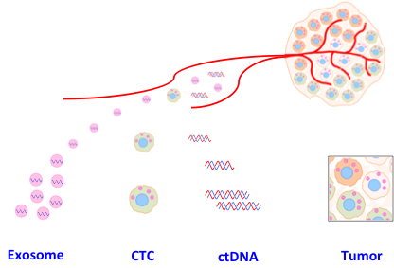
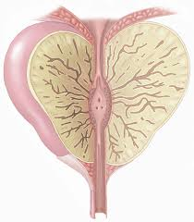


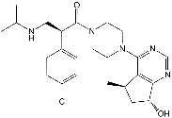

Outlook
Biomarker-driven precision drug development
AB, ADC, SMI
Prostate, gastric, TNBC, MM,…
ctRNA CTC ctDNA Tumor PDX
Therapeutics
Diseases
Biomarkers
Jia S, et al. Expert Review of Molecular Diagnostics, 2014
Notes:
Based on our own experience in drug discovery, disease biology, and clinical biomarker development, we published a perspective review article, illustrating the future need of comprehensive biomarker profiling. ctDNA and circulating tumor cells are the main focus of today’s discussion.

Slide 6
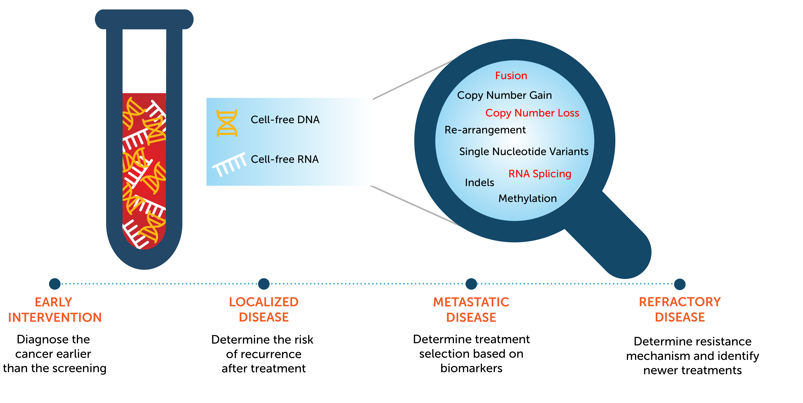
ctDNA – Next-gen Liquid Biopsy Technology Innovation
Predicine Differentiator:
cfDNA:
  gene deletion
cfRNA
  splicing, fusion
Low sample input
Notes:
Speaking about ctDNA, Predicine has developed its proprietary liquid biopsy NGS platform, enabling deep coverage of a wide range of common cancer variants. It detects SNV, Indel, fusion, CNV, TMB, MSI, etc.
As a differentiator, Predicine ctDNA technology can detect cfDNA based gene deletion, for instance, the bi-allelic deletion for BRCA gene or PTEN tumor suppressor gene.
Besides DNA, Predicine ctRNA technology can detect RNA splicing and novel fusion.
Today, Predicine ctDNA liquid biopsy assay has been widely used by leading global pharma in clinical studies, ranging from early detection and intervention, to localized and metastatic disease, and to resistance mechanism and recurrence detection.

Slide 7
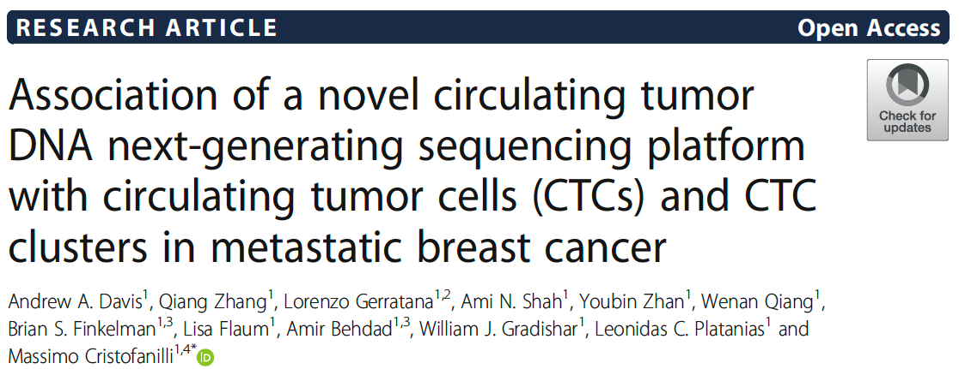
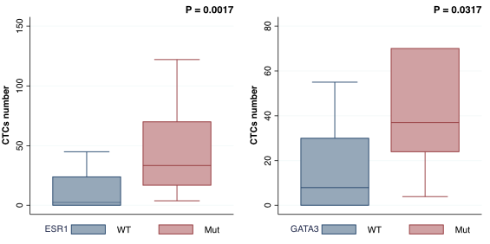
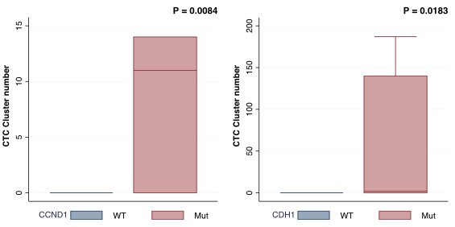
Beyond ctDNA – CTCs Provides Complementary Disease Insights
Integrative analysis of ctDNA and CTCs in metastatic breast cancer
Genomic alterations associated with CTCs
Genomic alterations in pts with CTC clusters
Predicine ctDNA assay identified genomic alterations in MBC pts, characterizing particular genomic alterations and different biology based on CTC enumeration and the identification of CTC clusters.
The potential of combining ctDNA and CTCs for comprehensive liquid biopsy analysis to accurately represent genomic heterogeneity and to detect resistance mutations in a non-invasive manner with implications for clinical management of patients with MBC.
7
Notes:
Beyond ctDNA alone, I would like to share with you our recent collaboration study with Dr. Massimo Cristofanilli at Northwestern University, demonstrating the association of Predicine ctDNA NGS platform with CTC and CTC clusters in metastatic breast cancer.
Specifically, this study reports that a higher number of CTCs was associated with genomic alterations in breast cancer genes such as ESR1 and GATA3. Furthermore, genomic alterations in CDH1 and CCND1were associated with a higher number of CTC. Of note, the CDH1 gene is involved in the production of epithelial cadherin (E-cadherin), a gene that plays an important role in cell adhesion, chemical signaling, cell movement, all of which may contribute to the metastatic process.
Collectively, this study demonstrates the complementary nature of ctDNA and CTC for comprehensive biomarker analysis and provide implications for clinical management of cancer patient.
I will pause here, and pass the microphone to Dr. Wenstrup to introduce EPIC’s CTC capability.

Slide 8

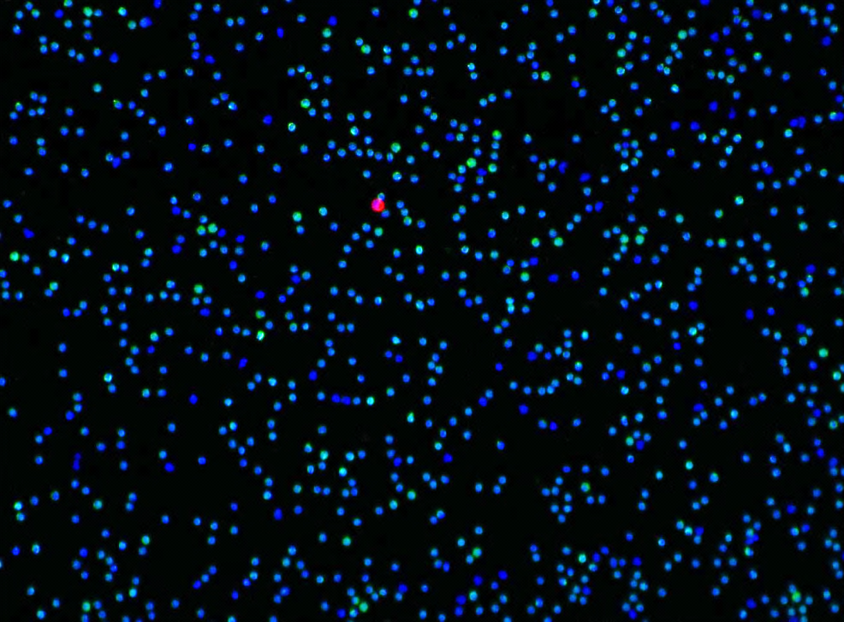





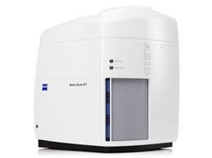

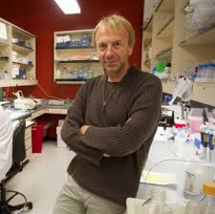


1 in10 Million Cells
Best in class limit of detection
No Cell Left Behind®
Contextual & comprehensive analysis: spatial, morphological, cellular and genomic information
Deposit Blood Cells
Stain Cells
Image & Analyze
WBC
CTC
Rare Cell Detection Platform
Red blood cells are lysed
Through a proprietary cell deposition process the WBC/CTCs are deposited
Visualization of all 3M cells
High Resolution Image Analysis
Image gallery is created
X/Y coordinates for each of the 3M cells
Slides differentially stained with molecular markers unique to WBCs & CTCs
Notes:
CTC is a carcinoma cancer cell found in the peripheral blood that has an intact nucleus, is positive for cytokeratin, negative for CD45, and has morphological features associated with cancer.

Slide 9
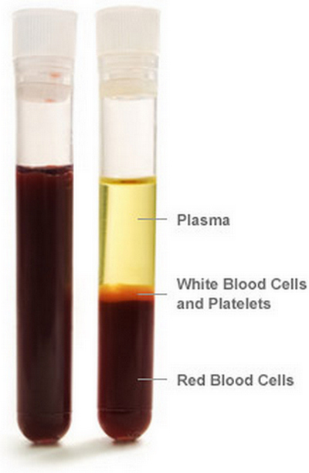
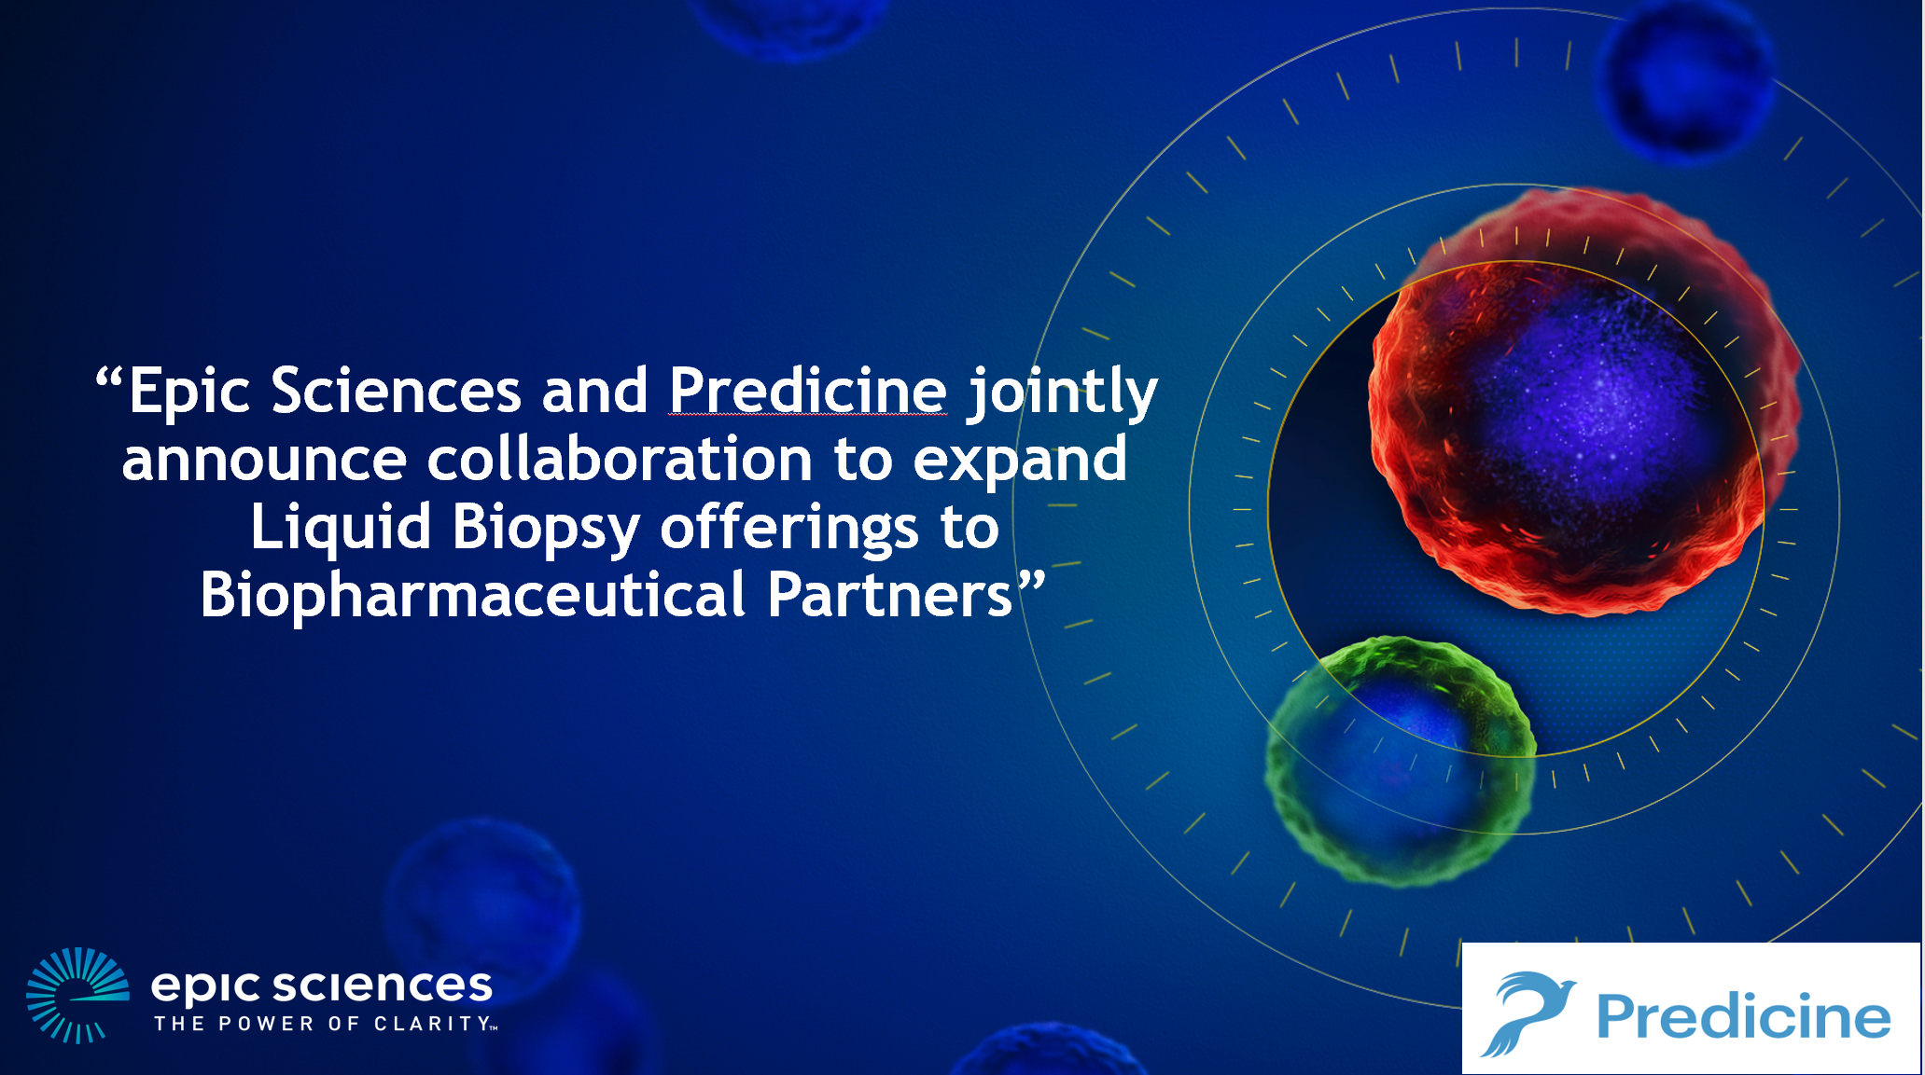
ctDNA+CTC Combo Allows for Full Potential of Liquid Biopsy
Comprehensive Cancer Profiling - both Genotypic & Phenotypic Analysis from a single draw of blood
Whole Blood After Separation
Plasma Fraction
ctDNA/cfDNA & other metabolites
Buffy Fraction
CTCs, single cell ctc-DNA & WBC analysis
RBC Fraction
Analyze or discard

Slide 10





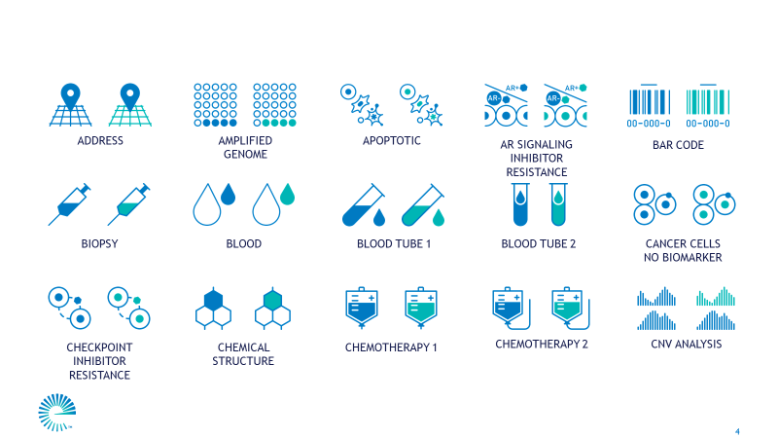



Predicine and Epic Sciences Partnership
Multi-technology testing of CTCs and ctDNA from a single blood draw
Complete Answers
Is the cancer still in remission?
Any ctDNA or CTC in the body?
CTC Enumeration
What cancer is this?
How is this disease evolving?
Biology
Immune Cell Characterization
What sub-type of cancer is this?
Is clonal evolution occurring?
Sequencing
Is the immune system engaged?
Are T-cells activated & fighting disease?
Is the immune system exhausted or suppressed?
Are IO targets primed to respond to therapy?
ctDNA
Comprehensive Cancer Profiling
CTCs
ctDNA+CTCs
No Information Left Behind
What cancer markers have changed?
What mutations match to targeted treatment?
What is the overall burden of disease in the body?
WBCs
Rare Cell
Detection
Phenotype /
Clonal Characterization
Is the patient responding to treatment?
Is the cancer now resistant to current treatment?
Single-Cell Genomics
What drug will my cancer respond to?
Notes:
Contained within this single blood draw is a mountain of information and while ctDNA companies can provide answers to certain answers, Epic’s platform can more complete answers to more questions:
To give an example:
Enumeration of CTCs in mBCa providing a gage of the patient’s prognosis and monitoring response.
Confirmation that newly suspected cancer is metastatic disease and not a new primary cancer
Resistance to other therapies through further treatment lines
Immune status is important not only to test for IO targets like PD-L1, but to understand if the patients’ T-cells are activated (CD4/8), or exhausted (TIM-3/PD-1), etc
ctDNA analysis of PiK3CA status determines if alpelisib is a tx option
Continued characterization of the protein expression as disease evolves will determine when new treatment will be needed and what treatment would be effective.

Slide 11

Comprehensive Cancer Profiling
Combines CTCs, ctDNA and tumor fraction analysis to identify key cancer markers
CTC and ctDNA analysis performed from the same patient blood draw
CTC Analysis
ctDNA Analysis
AR-V7, AR n-term, PSMA, SLFN11, PTEN
HER2, ER/PR
PD-L1, DLL3, N-cad, SLFN11, Ki67, gH2AX, HER2, ER/PR
AR, PTEN, PIK3CA, BRCA2, …
ERBB2, ESR1, PIK3CA, BRCA1, …
PredicineATLAS, PredicineCARE
Prostate
Prostate
Breast
Breast
BioPharma
BioPharma
Any approach that does not utilize both technologies is incomplete

Slide 12
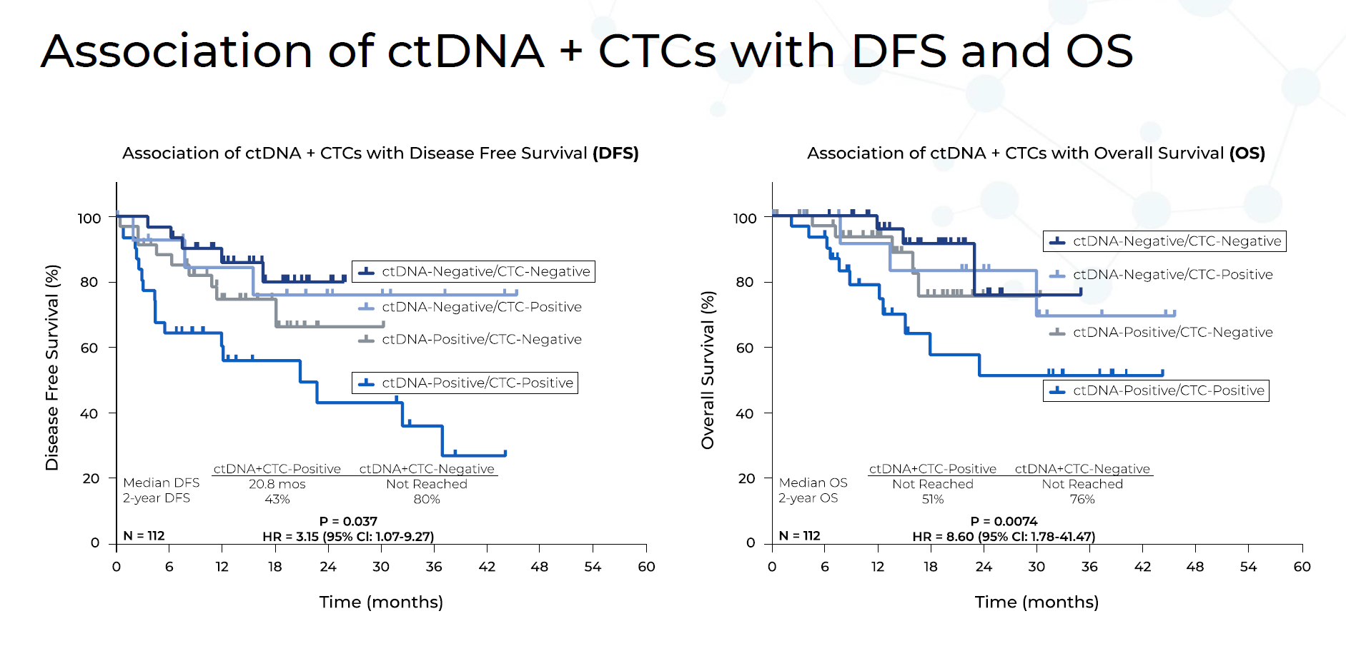
Combined Approach – Clinical Study, DFS/OS
Many patient samples were pos(+) for one, but not both types of LB
CTCs OR ctDNA sensitivity <80%. Combined sensitivity = 90%
Radovich et al. JAMA Oncology – July 9, 2020

Slide 13
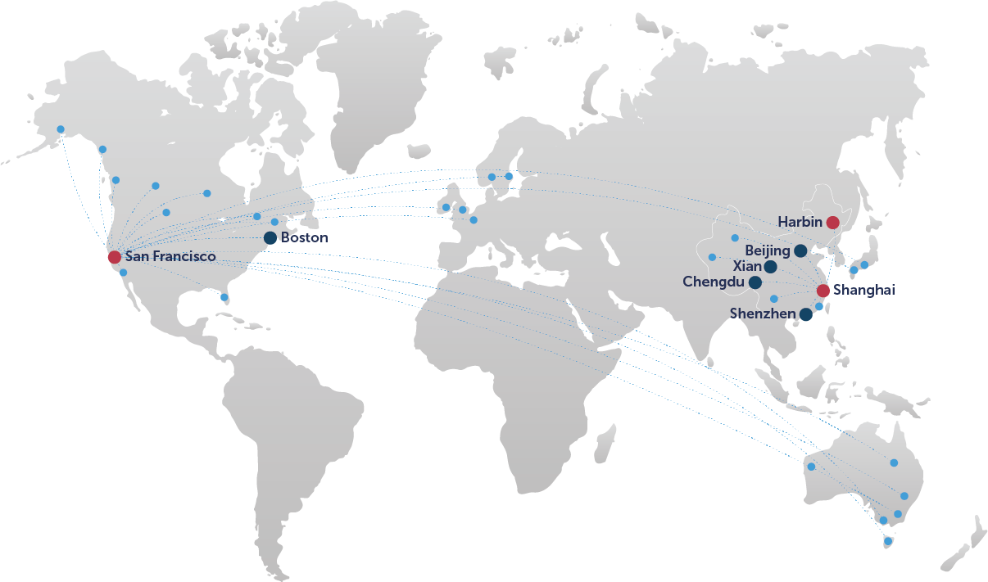

Global Footprint
CLIA/CAP facilities with cross-border operations to support global clinical trials
Predicine (EU)
(by 2021)
Epic Sciences
(Processing Facility via Covance)
Predicine (US)
Geneva
Predicine (CN)
San Diego
*
Epic Sciences
Singapore
Third party Dx lab
Epic Sciences
(Processing Facility via Covance)
Facilities
Office *
Clinical trial sites
Notes:
Thank you, Dr. Wenstrup.
Predicine and EPIC has established a global laboratory network.
We have CLIA and CAP laboratories setup in California, USA, Shanghai in China, Geneva in Europe, and Singapore in Southern Asia.
Through our global QMS system and identical SOP, we provide a harmonized assay in US, EU and China to support global clinical trials.

Slide 14


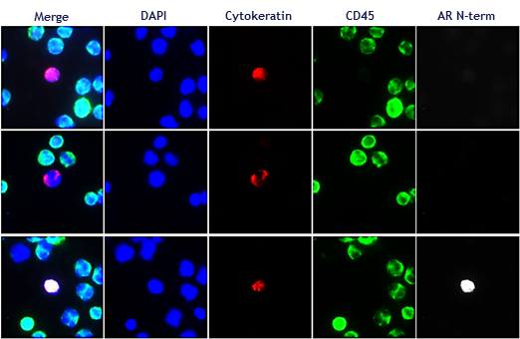
ctDNA and CTC Workflow Provides Ease for
Biopharma Clinical Programs
Comprehensive Cancer Profiling - both Genotypic & Phenotypic Analysis from a single draw of blood
CLINICAL SITE
Sample Collected
Sample Processed and Banked
PredicineATLAS™
PredicineCARE™
Biopharma Client
Comprehensive
Data Reporting
Plasma
ctDNA
CTC
CTC Slides
Notes:
In clinical studies, blood samples collected at the site will be sent to the lab of EPIC Sciences first for CTC isolation and plasma preparation. ctDNA molecular profiling will be conducted at Predicine lab, and CTC phenotypic profiling will be conducted by Epic lab, with the combo ctDNA and CTC result sent to pharma clients.
By this way, our integrated ctDNA and CTC Workflow Provides Ease for Biopharma Clinical Programs, and maximize the value of priceless blood sample. One set of sample, two sets of answers – both Genotypic & Phenotypic Analysis from a single blood draw

Slide 15
Pharma Adoption
We partner with 9 out of top 10 leading pharma companies in ctDNA and CTC studies
Notes:
As of today, we partner with 9 out of the top 10 leading pharma companies in ctDNA/CTC profiling. We have Companion Diagnostics programs ongoing in US and China.

Slide 16

Leveraging ctDNA and CTC to understand cancer deeper
Predicine and Epic to create global leadership to accelerate global clinical trials
+
The Future of Comprehensive Cancer Profiling with
One Blood Draw
Notes:
To summarize,
Predicine and Epic partner and create a global leadership in liquid biopsy.
The future of liquid biopsy has come, it is ctDNA and CTC-based comprehensive cancer profiling with one blood draw.

Slide 17

Notes:
With that, I would like to close this topic, and encourage you to consider how this next-generation, comprehensive ctDNA and CTC liquid biopsy solution may contribute to your clinical study. Please contact Predicine for ctDNA analysis and contact Epic for CTC study.
We thank you for your attention.

